Slide 1
The Use of Big Data
By Tate Barend, Tan Pham & Kevin Lee
Digital Humanities 101

Slide 2

Our Proposition
Our understanding of Big Data:
Big Data is the massive amount of data that is being created every second, by everyone.
While only a few are in the position to understand and analyze these Data sets.
Our presentation will focus on the accessibility of Data collection at an unprecedented scale and problems this poses as well as potential solutions within the Digital Humanities fields.
Notes:
Problem, context, solution.

Slide 3
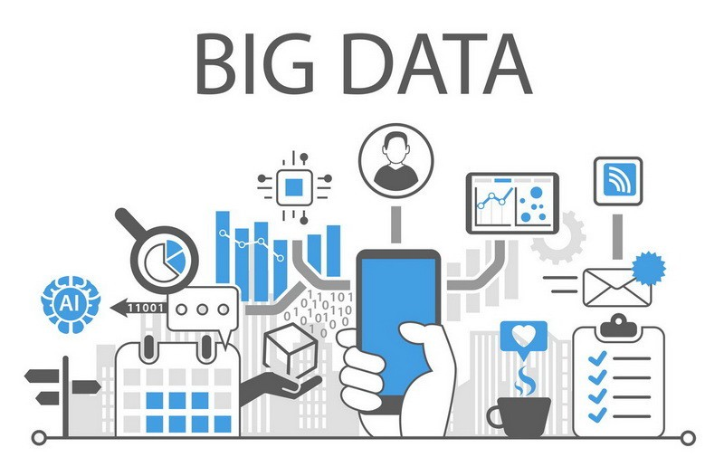
Introduction to Readings
“Critical Questions For Big Data” by Danah Boyd & Kate Crawford
A scholarly integration of the implications of Big Data
“The differences between digital humanities and digital history” by Stephen Robertson
Insight into some of the entry barriers and disciplinary differences that impact big data
“Against Cultural Singularity” by Alan Liu
specific practical applications to manage Big Data within the Digital Humanities themselves
Notes:
Scope of our group project is divided by three parts: Problem, context, solution.

Slide 4
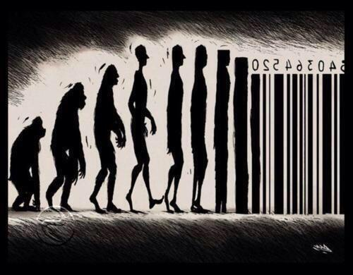
“This is a world where massive amounts of data and applied mathematics replace every other tool that might be brought to bear. Out with every theory of human behavior, from linguistics to sociology. Forget taxonomy, ontology, and psychology. Who knows why people do what they do? The point is they do it, and we can track and measure it with unprecedented fidelity. With enough data, the numbers speak for themselves.”
In 2008, Editor-in-Chief of Wired Chris Anderson

Slide 5
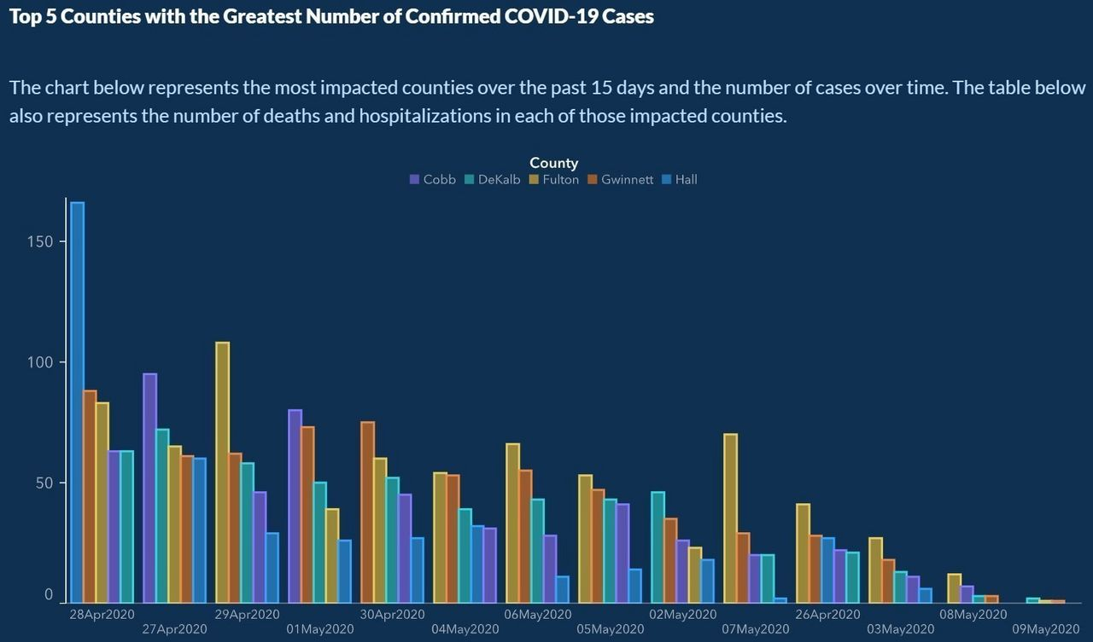
Boyd’s Big Questions for Big Data
Three classes of people in the realm of Big Data:
Those who create data: everyone who has a digital footprint.
Those who Collect it: Facebook, U.S Census, Google, all of the above
Those who have the expertise to analyze it: They are also the ones who get to determine the rules about how Big Data will be used, and who gets to participate.
Big Data doesn't mean Objectivity or Knowledge:
Big Data employees and scientist are mainly white and male.
Lack of Knowledge: Democratic big data fail in 2016
Bigger isn't always better!
More Tweets doesn't mean better scholarly understanding
Limited Accessibility to Big Data:
Insiders vs Outsiders
Berkeley funding vs Idaho State Funding
Data Companies have no responsibility to make their data available and get to control over who gets to see them!

Slide 6



Why Big Data? (Robertson)
Increased demand for digital expertise
Increased demand for digital expertise
Accessibility
Contextualization
Notes:
1st.
More jobs in the humanities field that encourage or require expertise in digital technology
Job advertisements in history, English, art history, archaeology, and media studies now include a regular sprinkling of positions requiring expertise in digital technology, some even as the primary field.
Undergraduate and graduate courses, certificates, and masters programs in digital humanities are appearing in a diverse range of institutions
2nd.
Entry into the workings of Big Data can help many scholars
Ex) Text analysis in big data can help derive meaningful data from unstructured text
Ex)
3rd.
working to obtain more access and additional digitized sources will require historians to confront their reliance on search as a research method and its limits as an approach to understanding digitized sources.
Scholars that are simply searching collections with an API as part of their research are missing an opportunity to put those search results into context.
The need to contextualize searches with Big Data, here, can offer historians the use of digitized collections to recover the history of individuals
Not just important figures, but ordinary individuals that may otherwise be lost in history
Roberton says This use of Text analysis will become more prevalent

Slide 7
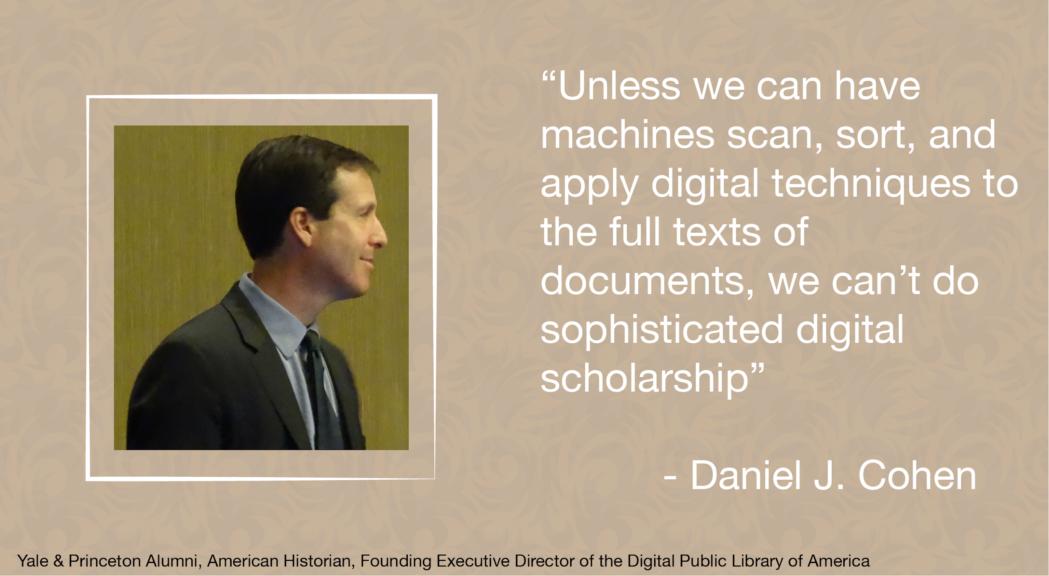
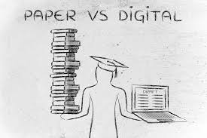

Drawbacks & Barriers (Robertson)
Lack of Digitized Sources
Costs of Accessibility
Data Limitations
Notes:
As Robertson explores digital history’s use of the Web and computational tools, he most importantly points out that the lack of digitized sources limits text analysis tools.
As Dan Cohen
(American Historian, Founding Executive Director of the Digital Public Library of America)
noted, “Unless we can have machines scan, sort, and apply digital techniques to the full texts of documents, we can’t do sophisticated digital scholarship”
Moreover, he notes that making digitized materials more accessible over computational tools is quite expensive and often time-consuming in the case of unpublished or printed sources that historians often rely on.
handwriting must be transcribed.
This suggests that the limits of working with Big Data drive scholars away due to their reliance on their current research methods.
In addition, many of the historical sources that are digitized are only accessible by search, in databases that do not have an API or other means of accessing the complete data.
This is particularly true of the commercial databases that contain digitized newspapers, a published source widely relevant to historical research and less so to other fields in digital humanities.
costresults that are returned are only images of the page, containing no machine-readable text. Not only is there no means of bulk export, but the licensing agreements expressly prohibit data mining.
Robertson concludes that humanities scholars who do not see their field being represented can become alienated due to discussions of digital humanities not acknowledging the different sources, approaches, and questions of humanities disciplines. To engage more scholars in digital humanities, using disciplinary terms alongside displaying the values and practices of digital humanities are key in helping them with their own disciplinary project.

Slide 8

Against the Cultural Singularity
Liu: cultural singularity refers to the point in time when all constituent parts of the present culture converge and are brought under the corporate framework and are capitalized.
Culture as forms of knowledge that become essentially products of "information capital"
The threat of “deep government and industrial drive toward gathering and extracting maximum value from data” without the representation of academia, and society at large. Also people like you and me.
- Alan Liu in "Against the Cultural Singularity," May 2016.
Notes:
According to Alan Liu:
“cultural singularity……….Culture, in the context of Cultural Singularity, debases itself into merely forms of knowledge that have essentially become products of “information capital”
(Note: We should see Cultural singularity as really a negative influence for the Digital Humanities)
The article by extent is also a thorough look into the intersection between Big Data and gathering information for the humanities just like Robertson’s Article.
Alan Liu fleshes out the challenges of inaccesibility to information Big Data provides and its effects on culture and the humanities
This surmounts to….all these academic institutions having to rely on Platforms maintained and operated by Big Data Companies
Does this allow academics, students, scholars and digital humanities professionals easy access to what they are looking for
These methods and techniques to access these sources prove to be not as easily readily available for patrons according to Liu
He then provides solutions -- important solutions -- within the Digital Humanities’ sphere to counter the role of a monolithic “Cultural Singularity” that is caused directly by Big Data’s selective management of vast/incomprehensible sources of data.
We as students in the digital humanities have to watch out for the threat of the collusion between agents of the quote-on-quote “the deep government and industrial” toward extracting their own maximum value from the data, often times the data in the possession by our own hands created and crafted by our own selves,
without any representation from academia and society at large.
People like you or me. Therefore, we have to look out for lack of representation from academia and us Digital Humanities students that exclude Our access to Data. Even often times Data created by own ourselves.

Slide 9

Against the Cultural Singularity
What remedies are there within the Digital Humanities sphere to help circumvent the imposition of power structures that hinder the flow of information in academia?
One possible solution is Open-Source
Github is the most popular platform for sharing open-source software
Notes:
Liu’s overall strategy is the implementation of “new practices surrounding rigid structures”
One such possible solution is open-source / open-access / open-media, specific examples conol like creative commons.
We will just call everything “open-source” and focus on open-source
And your favorite as we have heavily delved into in this class, Github is the most popular platform for sharing open-source software.

Slide 10
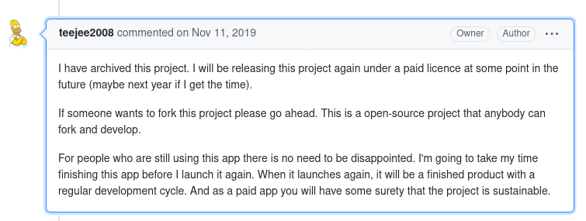
Notes:
Do you see any problems, issues or concerns associated with this particular image.
Yeah, you can see some of the shortcomings of the availability of open-source software playing out.
AS YOU CAN SEE
Making it a paid app, the whole process is not actually sustainable.
As project author, in the process of creating their project in an OPEN SOURCE environment, can be trapped by companies developers going through and appropriating the data, and used for themselves before the project reaches its completion.

Slide 11
Against the Cultural Singularity
Open-source as a code word for 'trial version'
Possibility of corporate developers exploiting open-access products from Github for free for their own motives and profit
eventually Github users pay their developers for their own project
Does this allow for large companies like Microsoft to take over "open-access"?
Precludes Liu's expressed concerns and desires to prevent the mismanagement/take-over of Big Data within spaces like academia by corporate interests/big businesses as a clear example of "cultural singularity"
Notes:
I don’t want to end with quite a pessimistic outlook to the entire situation, but please take a look at recent applications of open-source as a means and measure to get
around inaccessibility, inscalability of Big Data management
But, many recently theorized open-source as become essentially a code word - a by word - for “trial version”
In that it gives corporate developers the possibility to exploit the open-access code and products from Github for their own benefit, utilizations, motives and for their own
Profit
We even see cases in recent times in which Github users complain they pay developers later on for their own project with acknowledgment or monetary compensation
We must ask the question: Does this allow for large companies like Microsoft to take over “open-access”????
This actually all precludes Liu’s expressed desires and concerns to prevent the mismanagement/eventual take-over of Big Data within spaces like academia by corporate interests and big businesses.
(Therefore)...These recent actions by Big Companies that manage Big Data all encourages and promotes THE CULTURAL SINGULARITY

Slide 12
Conclusion
“The era of Big Data has only just begun, but it is already important that we start questioning the assumptions, values, and biases of this new wave of research.”
-Boyd
Notes:
Nan Z. Da: forming new visions of how they imagine and interpret computational literary studies, how they all tie in together. While using Data in Humanities research doesn't mean understanding of the subject.
Our presentation focused on the accessibility of Data collection at an unprecedented scale and problems this poses as well as potential solutions to this within the Digital Humanities fields.
Shared understandings and often-times interdisciplinary approaches to open the pathways to Big Data, traditionally viewed as exclusive
There is a need within the humanities to increase access towards and foster accountability in Big Data.

